Slide 1

Friends of the
Little Miami State Park
Annual Membership Meeting
April 28, 2024

Slide 2
Agenda
Welcome and Introductions
FLMSP Mission
Election of Board Members
2023 Little Miami State Park Activities
2023 FLMSP Accomplishments
Treasurer’s Report
2024-25 Little Miami State Park Activities
FLMSP Big Plans for 2024-2025

Slide 3
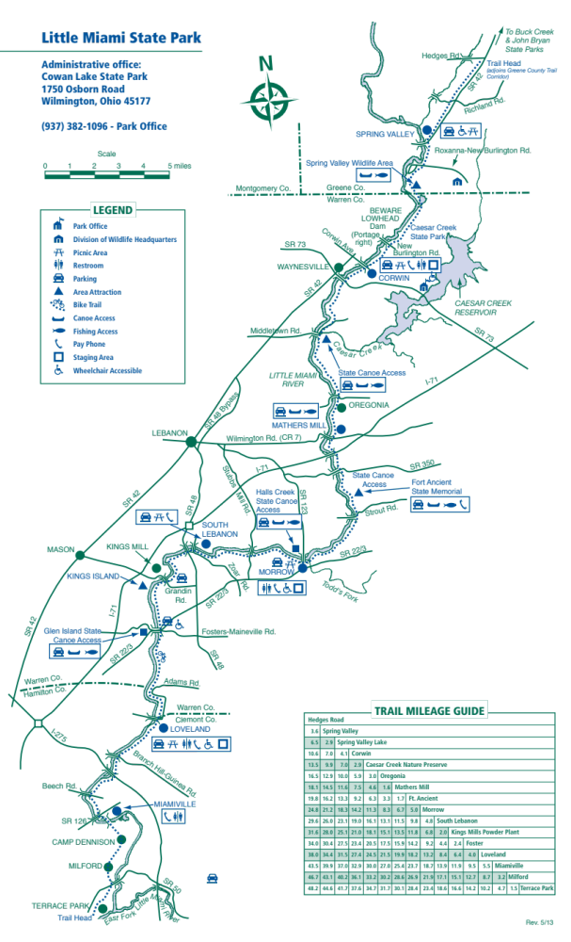
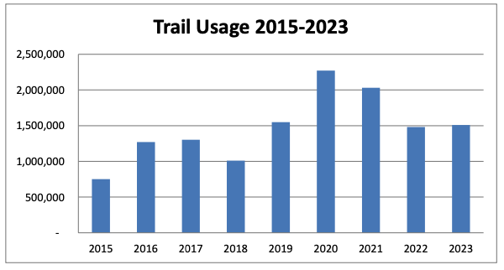
Little Miami
State Park
Part of Little Miami Scenic Bike Trail
From: Hedges Road (Xenia)
To: Avoca Park (Terrace Park)
Length: 50 miles
Intersections: 44
Bridges: 16
2023 Trail Visits – 1,509,026
  Up 1.85% from 2022

Slide 4







Active 15 Years
100% Volunteer Organization
Mission -- create a rewarding user experience on the Little Miami State Park trail by improving its safety, condition, convenience, and beauty in a manner consistent with its natural river setting.

Slide 5
Management
2023-24 Board
Board Consists of 7 Members
  4 Officers
    President
    Vice-President
    Secretary
    Treasurer
  3 At-Large Members
  Each Position is a Two Year Term
President 2023-2025
  Dick Feldmann
Vice President 2022-2024
  Ron Gorley
Secretary 2022-2024
  Bill Brown
Treasurer 2023-2025
  Becky Retzer
Board Members at Large
  Fritz Buschmann 2022-2024
  Larry Bloomfield 2022-2024
  Bruce Cortright 2023-2025

Slide 6
Management
2024-25 Board
Board Consists of 7 Members
  4 Officers
    President
    Vice-President
    Secretary
    Treasurer
  3 At-Large Members
  Each Position is a Two Year Term
President 2023-2025
  Dick Feldmann
Vice President 2022-2025
  Ron Gorley
  Agreed to serve another year
Secretary 2024-2026
  Bill Brown
  Agreed to serve another term
Treasurer 2023-2025
  Becky Retzer
Board Members at Large
  Rick Forrester 2024-2026
  John Telintelo 2024-2026
  Bruce Cortright 2023-2025
  Nominations from the Floor
Vote to Approve or Reject Candidates to the Board

Slide 7
2023
Little Miami State Park
Activities

Slide 8
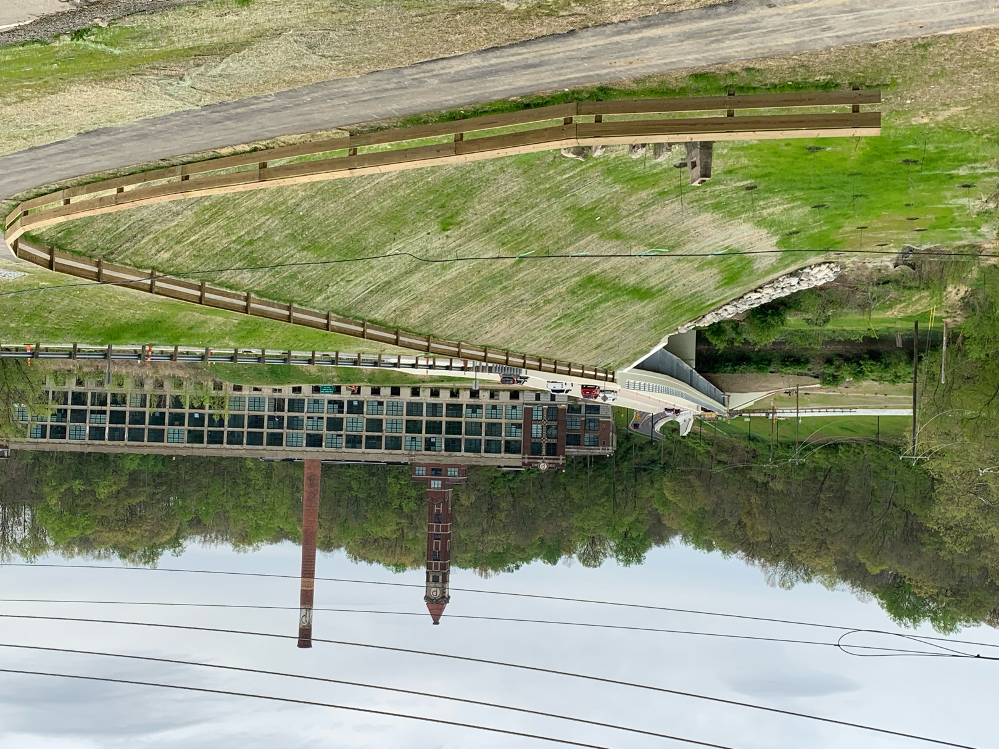
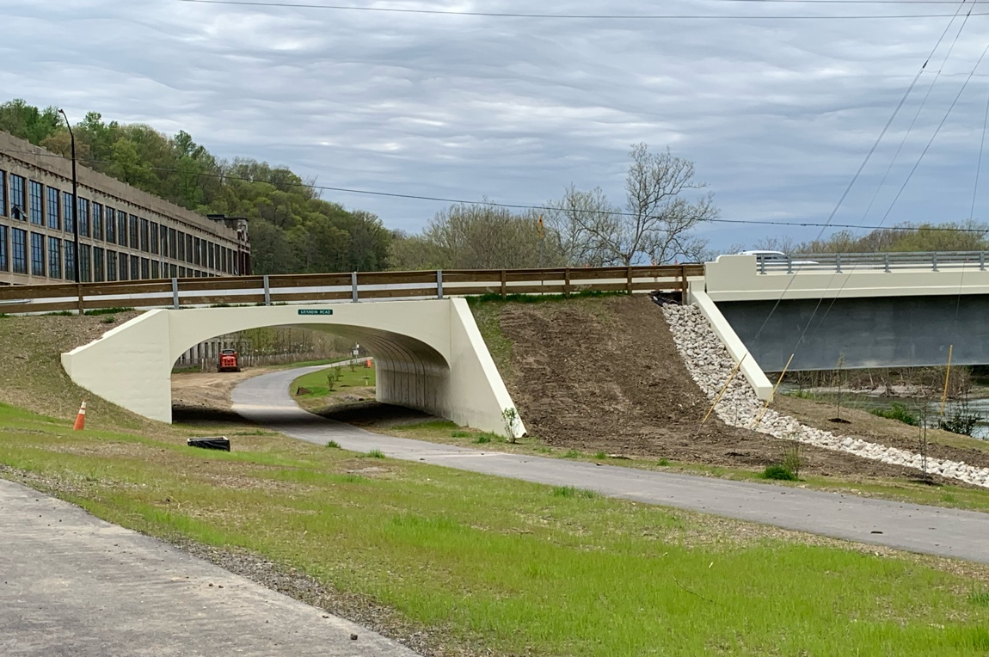
Grandin Rd. / Cartridge Factory
Bridge is Finished!!!
Project of Warren County
Includes a tunnel for the trail, eliminating a dangerous road crossing.

Slide 9
2023
FLMSP
Accomplishments

Slide 10
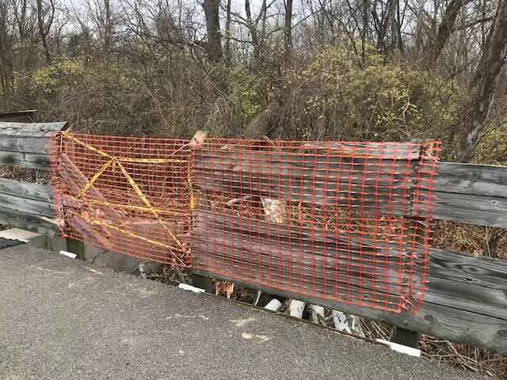
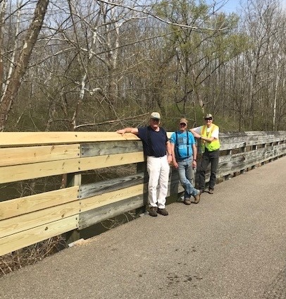
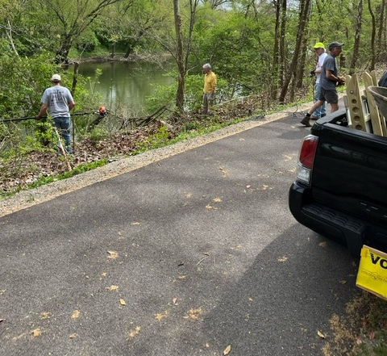
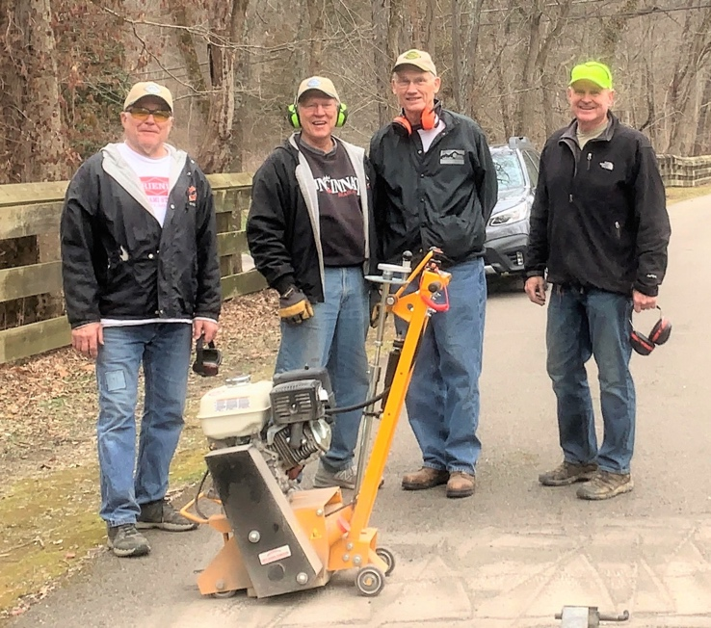
On-going Activities
Our volunteer teams have been:
Cleaning up ditches and opening culverts
Trail Blowing
Fence Repair
Memorial Benches
Portable Restrooms
Trail Use Monitoring
Down Tree Removal
Trail Surface Maintenance

Slide 11
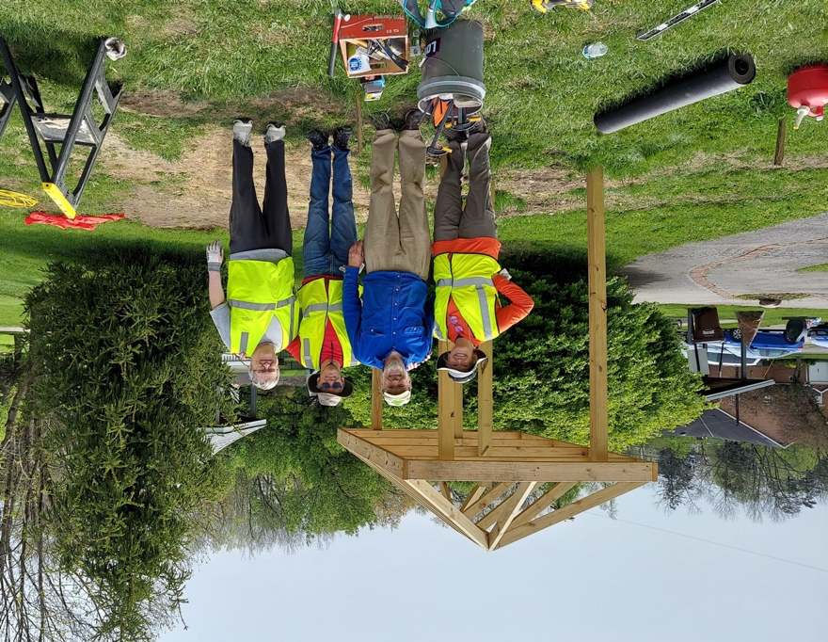
Village of Morrow trail access improvements
Remove existing 3-sided structure
Building new standard information kiosk with 6 display cases
Adding memorial bench
Plant decorative trees to replace Flowering Pears removed in 2021
Plant butterfly garden on three sides of restrooms
    With funding from Appletree Pet Clinic
    And assistance from Greenfield Farms

Slide 12
Improved Volunteer Engagement
123 Active Volunteers supporting FLMSP activities and projects
Volunteer Events
Held 3 Volunteer Gatherings in 2023 as thank you to Volunteers
Provided LaRosa’s Pizza to all active volunteers at end of 2023.
Volunteer Management
Volgistics web-based volunteer management database

Slide 13
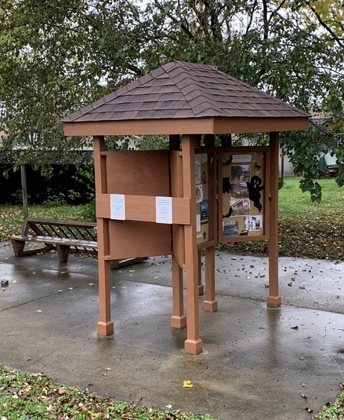
Community Outreach
  Kiosk Displays
  Hotline
  Website
  Trail Mail
  Facebook
  Twitter
  513-212-6958
  https://LittleMiamiStatePark.org
  Sign up on website
  FriendsLMSP
  @FriendsoftheLM

Slide 14
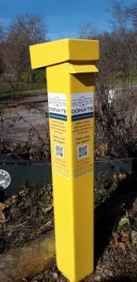
Treasurer’s Report – Income
 | Jan – Dec 2023 | Jan – Mar 2024
Contributions and Support
Earthshare | 241 | 304
General Donations/Memberships | 55,831 | 6,797
Kroger | 629 | 216
Employer Match | 1,075 | 1,050
Grants to the General Fund | 30,224 | 3,450
In Kind Donations | 3,038
Pipe Safe Donations | 859 | 121
Restricted Grants – Trail | 24,620
Total Contributions / Support | $116,536 | $11,938
Reimbursement of Shared Expenses | 671 | 194
Other Revenue: Interest | 2,160 | 593
Total Income | $119,367 | $12,725
As of March 31st 2024

Slide 15
Treasurer’s Report – Expenses
 | Jan – Dec 2023 |  | Jan – Mar 2024
Trail Maintenance/ Improvements/ Programs | $56,656 | 80% | $7,485 | 78%
Volunteer/Donor/Community Outreach | $8,632 | 12% | $1,782 | 19%
Administration | $5,031 | 8% | $304 | 3%
Total Expenses | $70,319 | 100% | $9,571 | 100%
As of March 31st

Slide 16
Treasurer’s Report
Income vs. Expenses
 | 2022 | 2023
Revenue | $84,750 | $119,368
Expenses | $53,254 | $70,319
Net Operating Revenue | $31,496 | $49,049

Slide 17
2024-25
Little Miami State Park
Activities

Slide 18
ODNR Park Management
Park Manager – Tiffany DeChant-Hunt
Caesar Creek SP Park Manager
Maintenance Lead – Casey Marcum

Slide 19
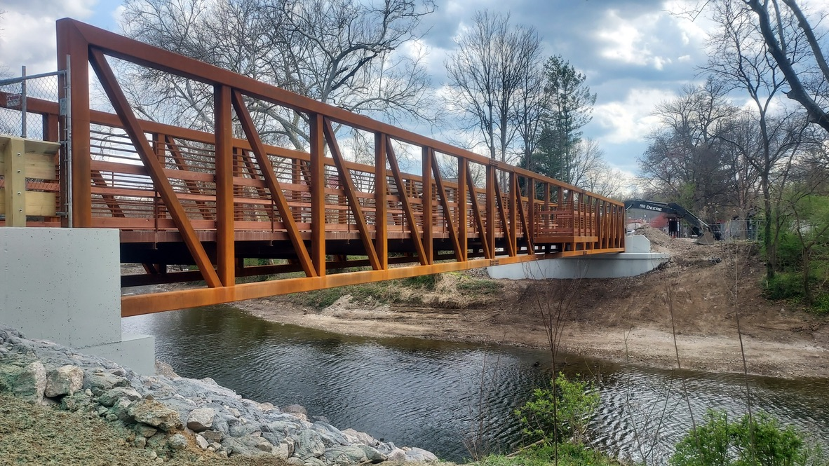
O’Bannon Creek Bridge
Loveland
Replacement of Bridge this past winter by ODNR

Slide 20
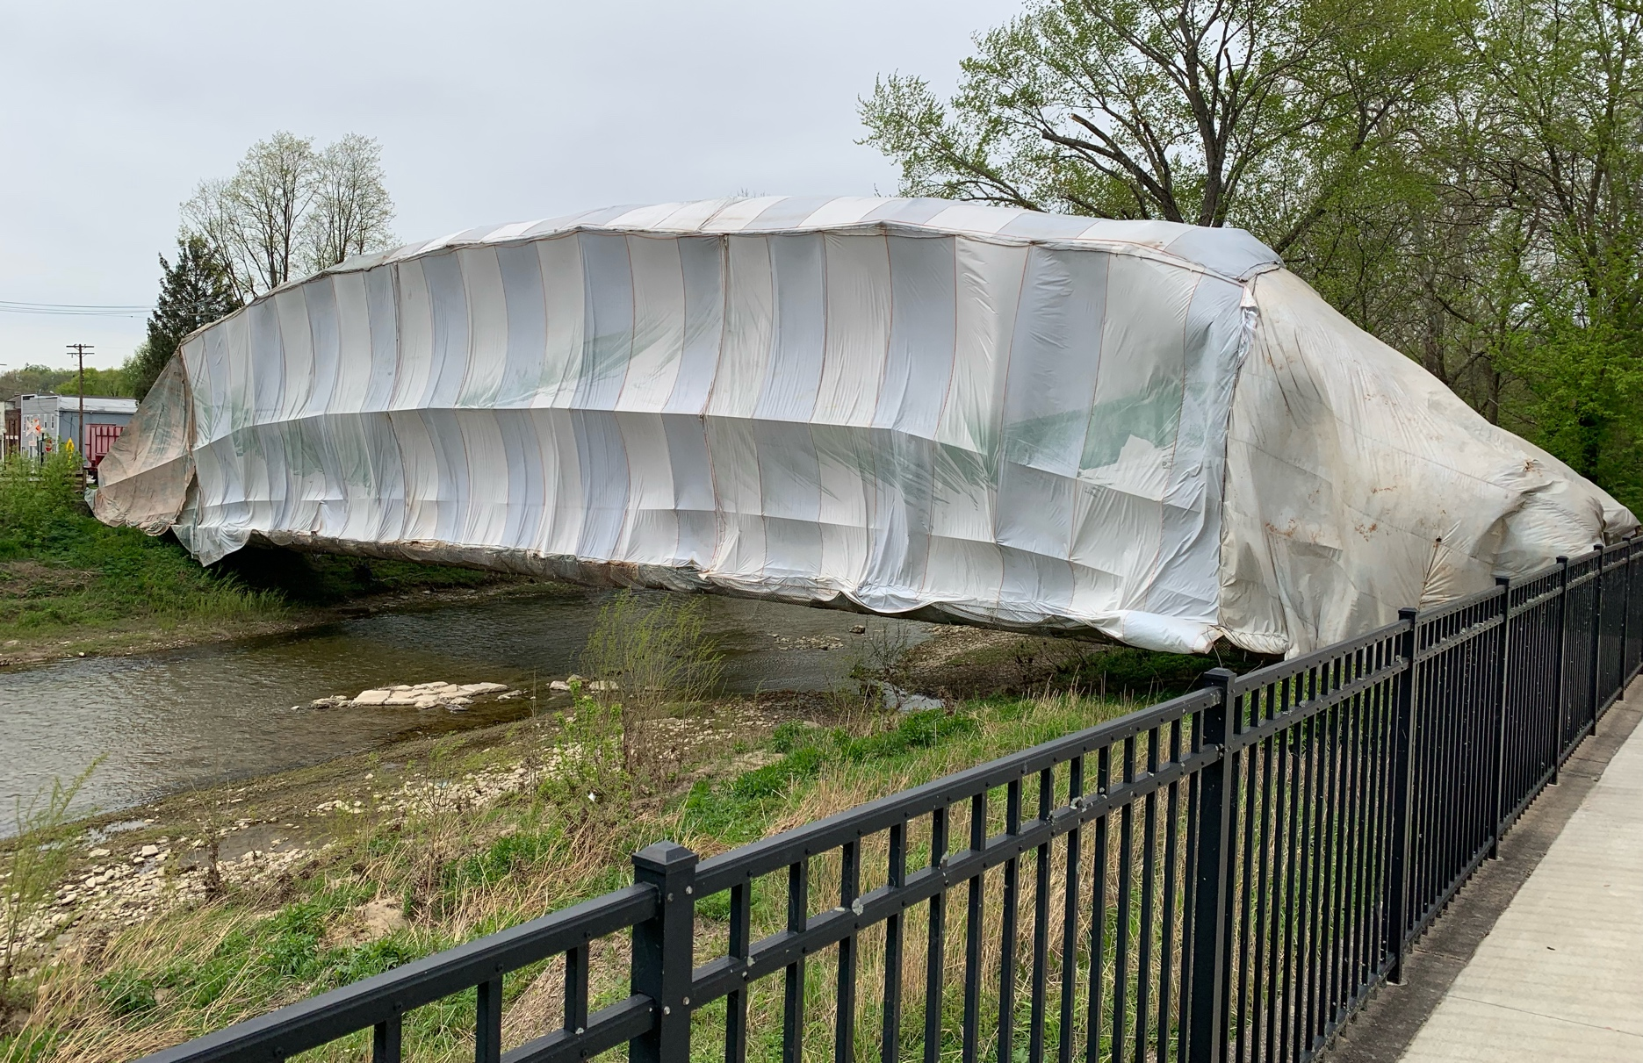
Todd Fork Bridge Painting
Morrow
Maintenance and Painting of bridge April & May 2024 by Village of Morrow and ODNR

Slide 21
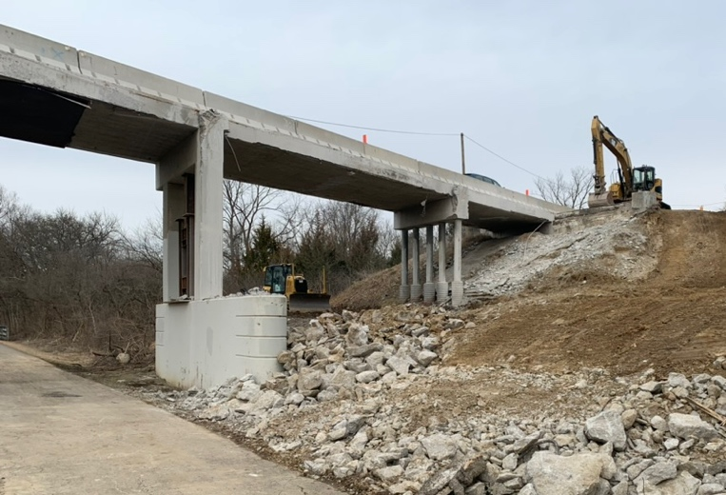
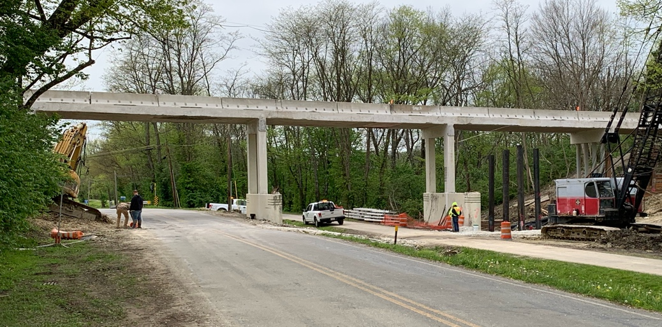
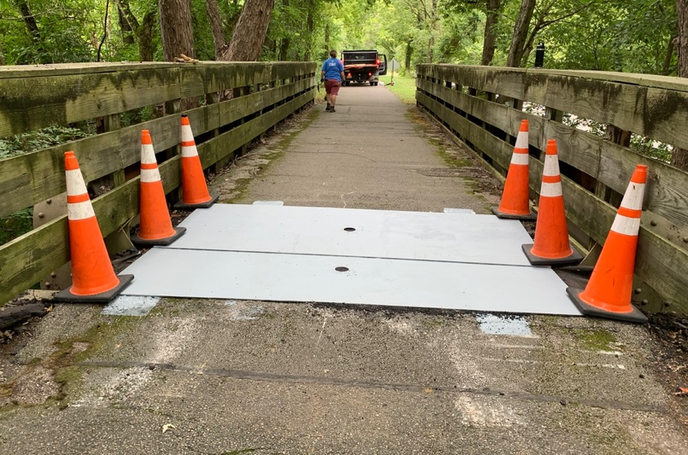
And More Bridge Replacements
Route 42 road bridge replacement Spring Valley
(ODOT)
Route 73 road bridge replacement Corwin
(ODOT)
Middletown Rd & Corwin Rd (MM 16.5) trail bridge replacement Oregonia
(ODNR)

Slide 22
FLMSP
Big Plans for
2024 - 2025

Slide 23
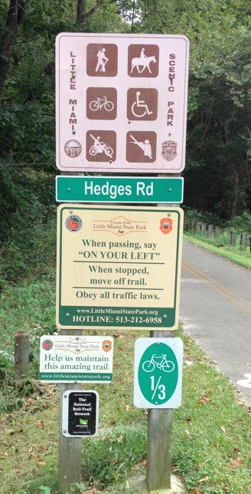
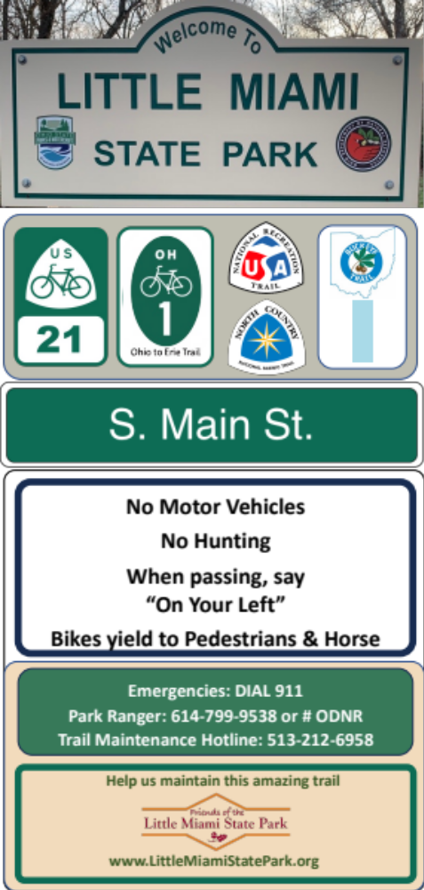
Park Sign Replacement
Park Entry Signs at 44 Road Crossings
  40 years old.
  Replace Signs with new ODNR branding
  Correct Information

Slide 24

Grandin Rd. / Cartridge Factory trail access improvements
PROPOSED/CONSIDERING
Adding Park sign tree
Building information kiosk with three display cases
Erect Picnic Shelter
Adding memorial bench
Plant decorative trees
Plant butterfly garden
    Funding from Appletree Pet Clinic

Slide 25
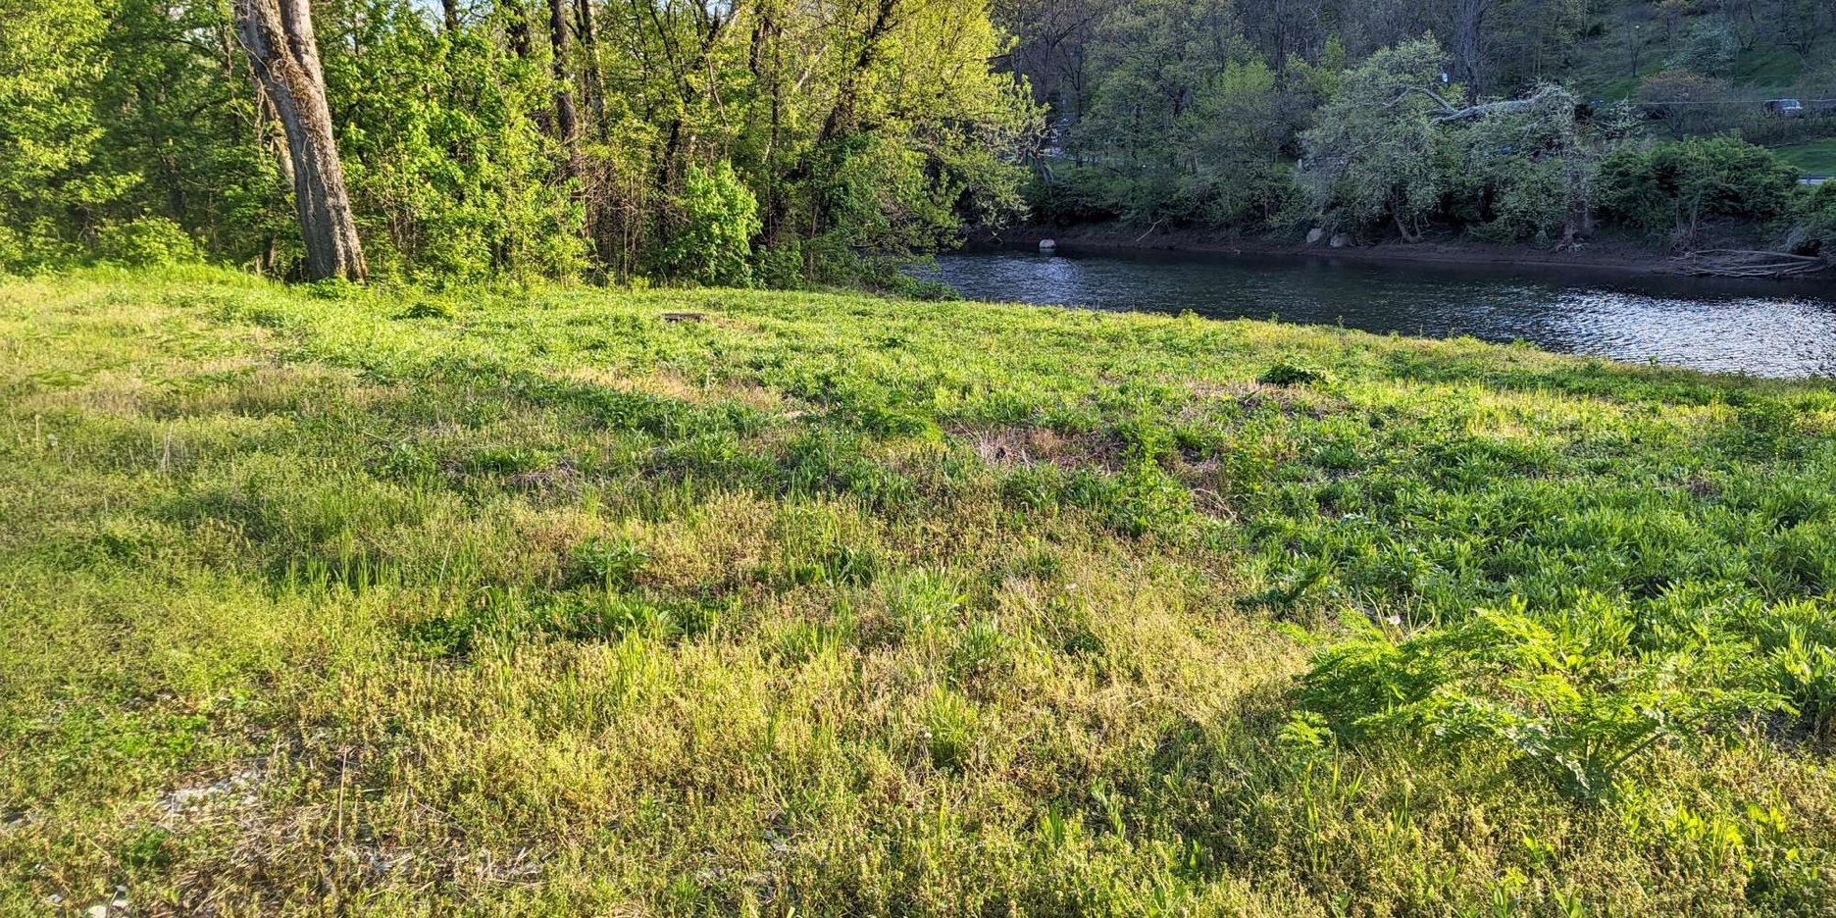
Pollinator Gardens
MM 39.1 Existing Pollinator Garden South of Fosters on Duke Energy property existing and doing well.
MM 19.9 Oregonia Pollinator Prairie.
Three or four more pollinator gardens just off trail.
Greenhouse for propagating Ohio Native Species.

Slide 26
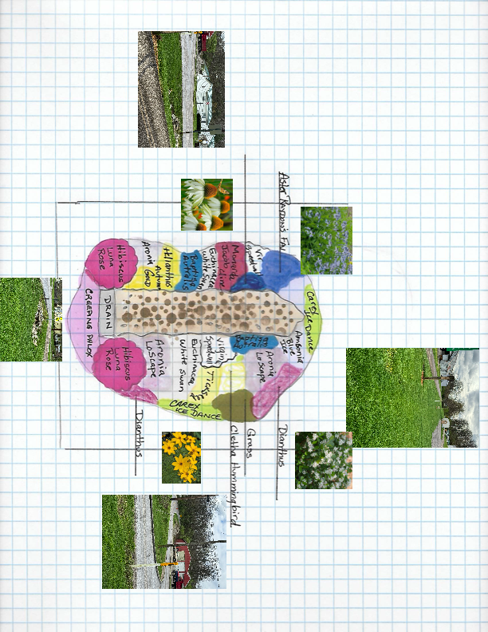
Raingarden – S. Lebanon Trailhead
$10,000 - Warren County Soil & Water Conservation – 2023 Operation Rain Garden Grant

Slide 27
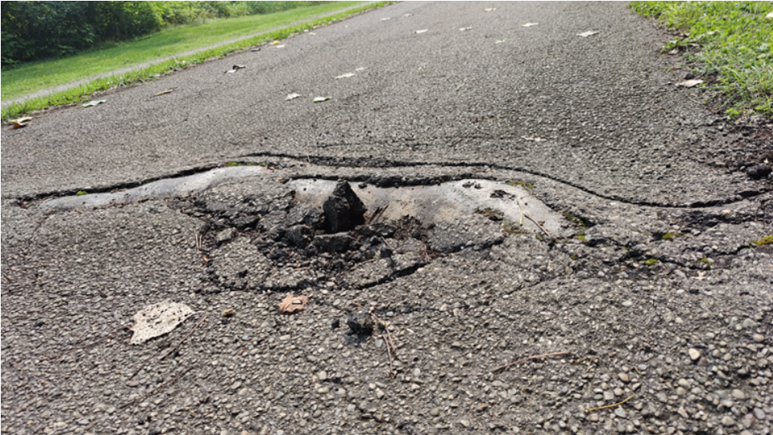
Repave 3.0 mile 40 year old trail segment
Requesting $296,500 from Ohio Capital Budget through Warren County Chamber Alliance.
South Lebanon providing $148,500 for 9/10 mile. Part of a water or sewer line extension.
FLMSP board has committed $50,000.
Awaiting Ohio Senate Capital Budget bill to pass in July 2024 timeframe.
Example of pavement failure

Slide 28
ODNR
Thank You!
Questions

